Slide 1
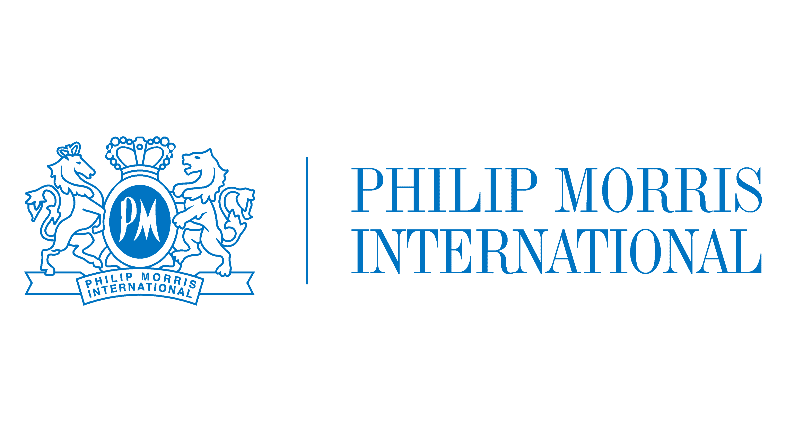
Philip Morris International
Sector: Consumer Staples
Sub-Industry: Tobacco
Recommendation: BUY
Presented by:
Shikhar Gupta

Slide 2
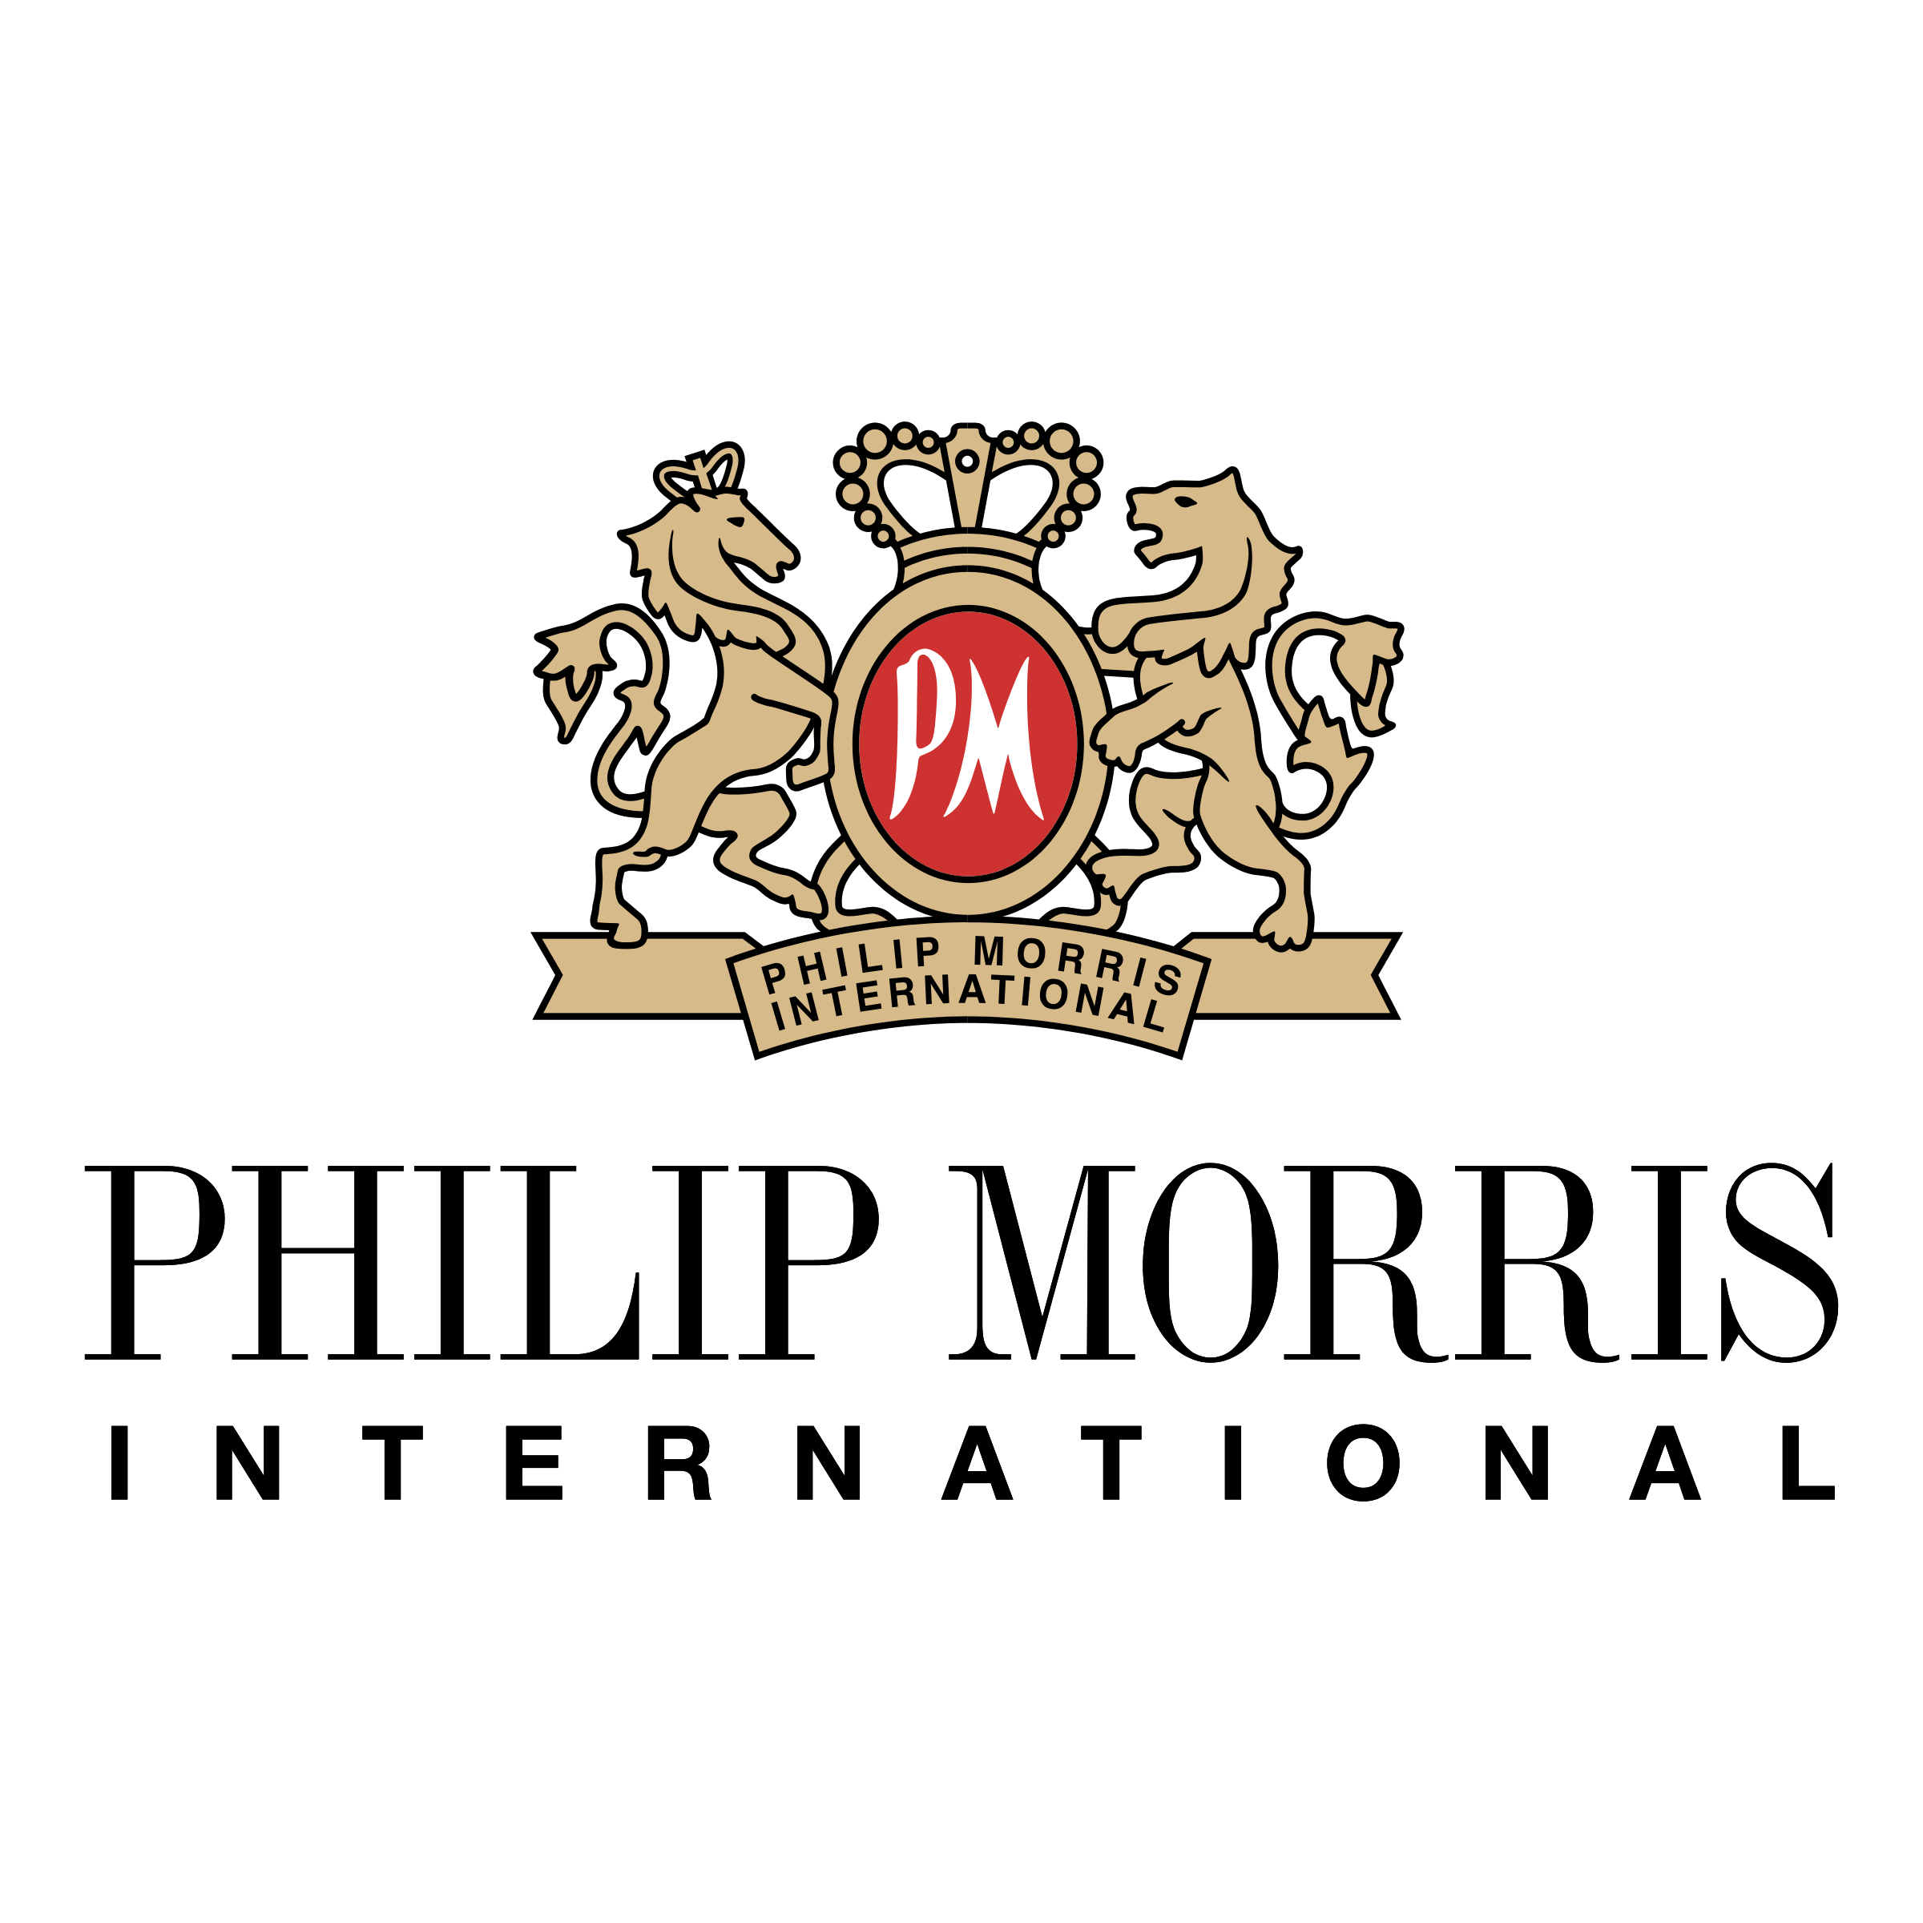
Overview
Behind PM
Business Segments
Understanding PM
Industry Analysis
Competitor Analysis
SWOT Analysis
Investment Thesis
Catalysts
Valuation

Slide 3
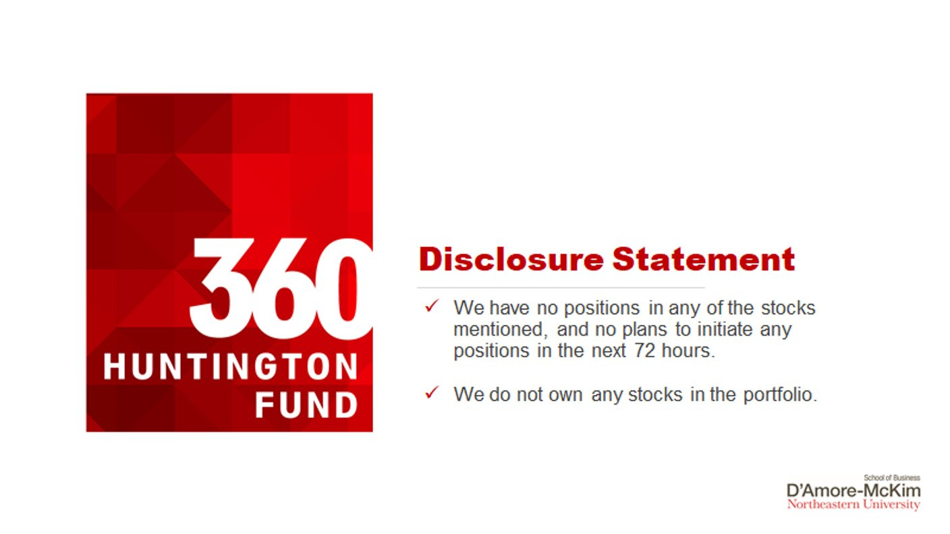

Slide 4

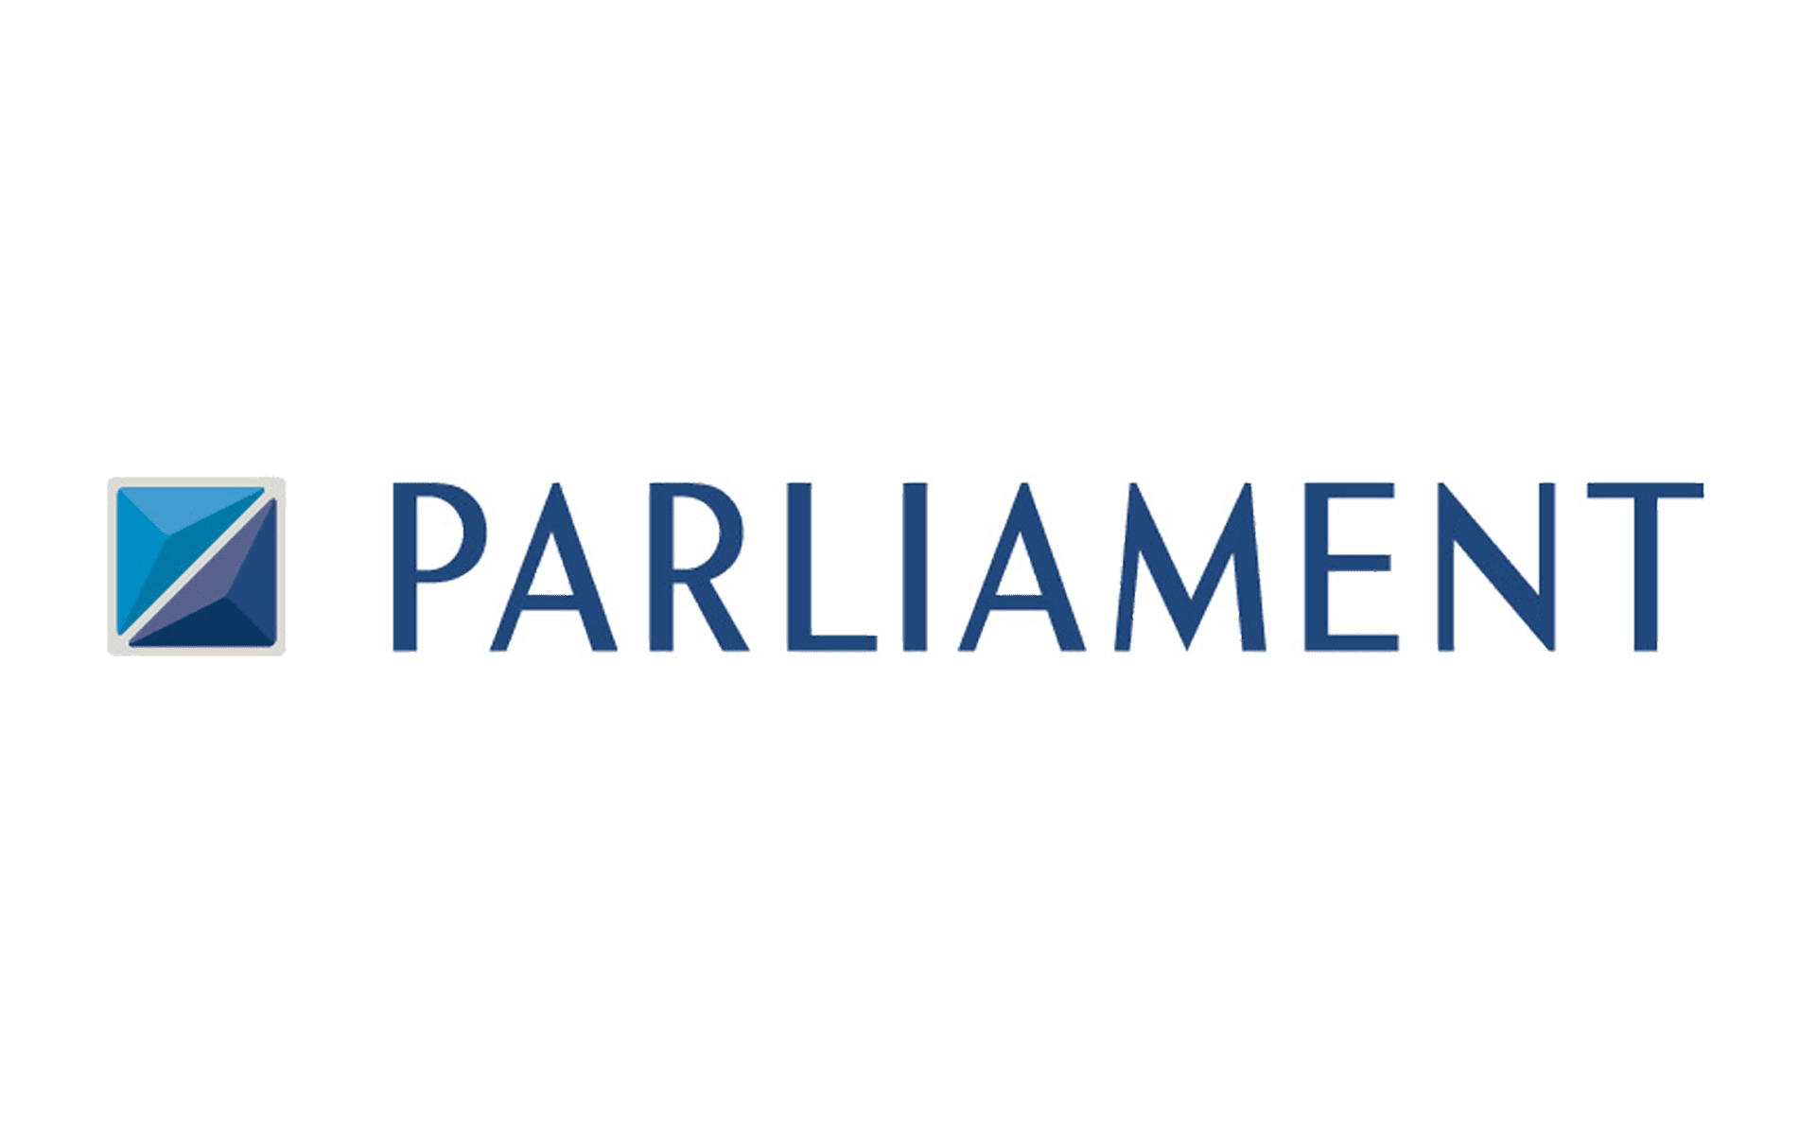
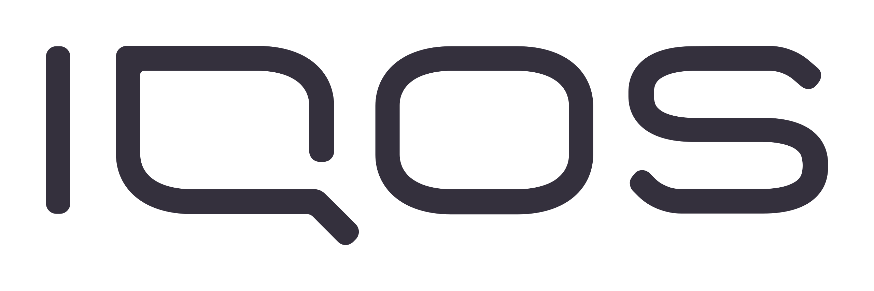
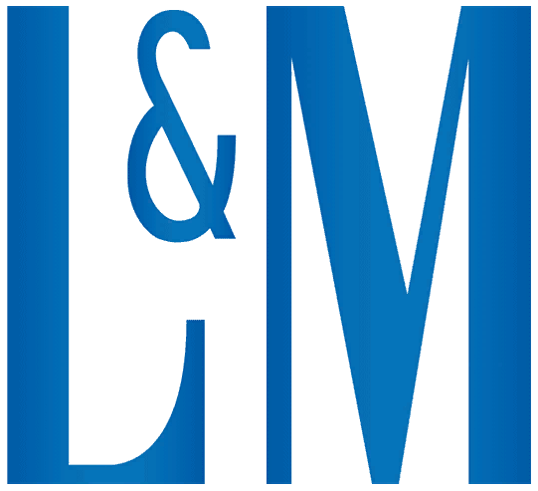
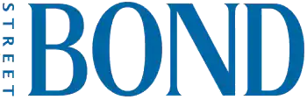
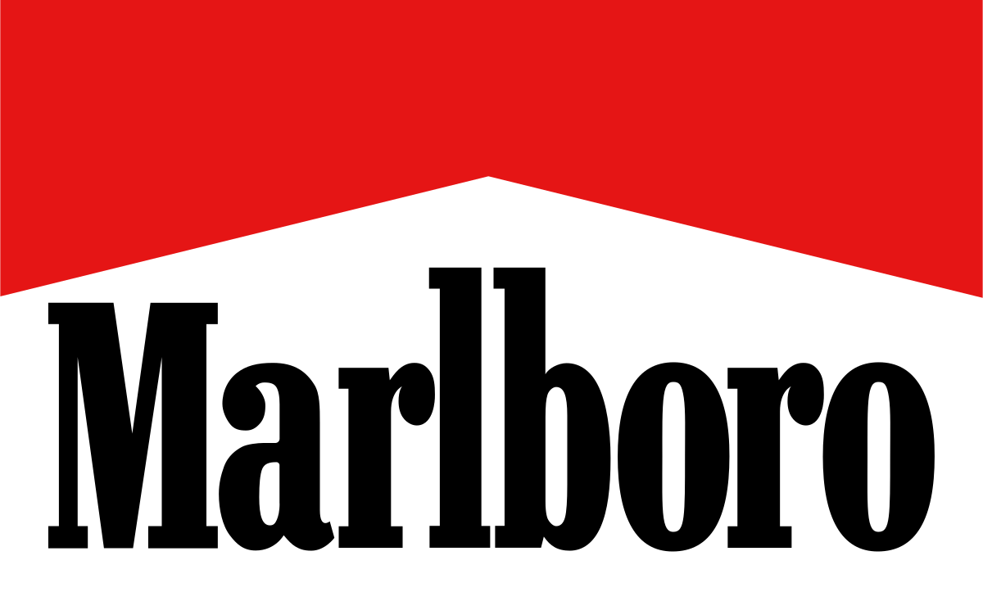
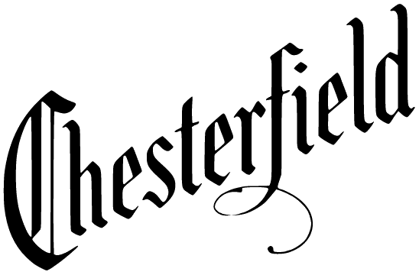



BUSINESS SEGMENTS
The company's product portfolio primarily consists of:
Cigarettes
Smoke-free Products: including heat-not-burn, vapor, and oral nicotine products primarily under the IQOS (“I quit ordinary smoking”) and ZYN brands
Consumer accessories: Lighters and matches. It also offers wellness and healthcare products.

Slide 5




BEHIND PM
Stock Exchange: NYSE
Ticker: PM
1987
Stamford, Connecticut
Building PMI’s future on smoke-free products that, while not risk-free, are a far better choice than cigarette smoking

Slide 6
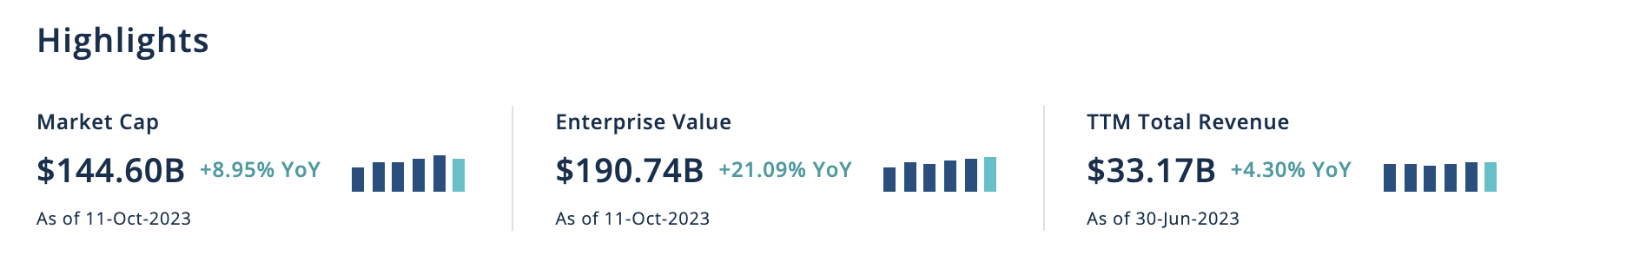
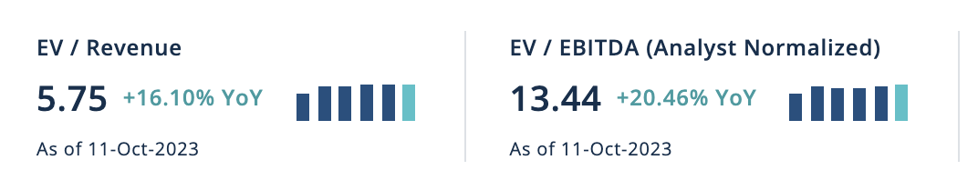
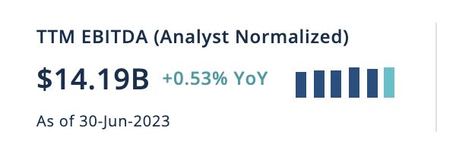
UNDERSTANDING PM (Key Stats)

Slide 7




INDUSTRY ANALYSIS
Growth Rate:
The Global Tobacco Market is estimated to witness a CAGR of 3.75% in the upcoming five years. (Source: CFRA Report)
Taxation:
Tobacco is one of the significant sources of tax revenue for governments worldwide.
Owing to tax regulatory environments, developing economies are now fueling growth in the market
Key Players:
The global tobacco market is consolidated and comprises a few large players who hold most of the share in the market.
Recent Trends:
Rising Popularity for low Tar, Nicotine Products

Slide 8

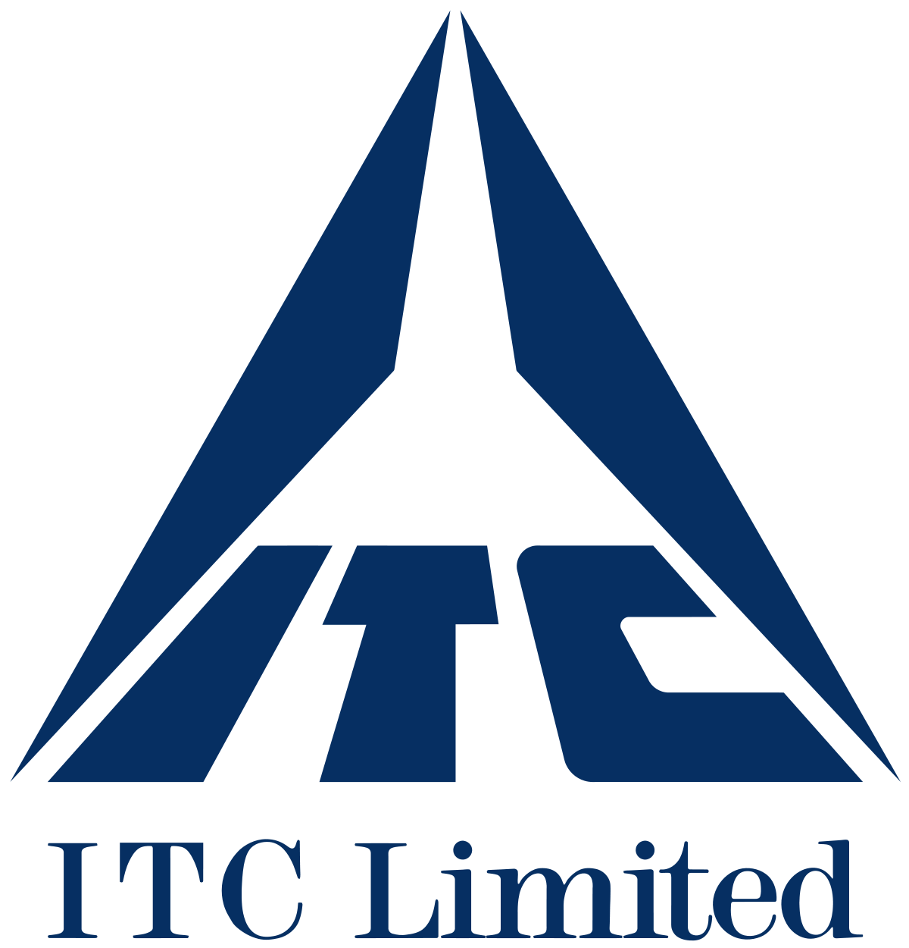


Competitor Analysis
Market Capitalization ($ Billion) | Revenue ($ Billion) | Operating Margin (%)
$144.6 | $33.17 | 33.60%
$40.26 | $20.28 | 24.29%
$18.94 | $39.25 | 10.64%
$67.67 | $33.95 | 62.13%

Slide 9
SWOT Analysis
Strengths :
Strong distribution network
Weaknesses :
Weak organization structure:
Threats :
Opportunities:
Imitation of the counterfeit and low-quality product
Good Returns on Capital Expenditure
Need of Technology Investment
New customers from online channel
New environmental policies
Negative impact from the Russia and Ukraine war

Slide 10
Investment Thesis
Strong Dividends
Capital allocation properties were altered by the recent acquisition but management is committed to its high 80% dividend payout ratio.
Secure Portfolio of Brands
Powered mainly by Marlboro, Parliament
Transition to a Stable Business Model
Emphasis on smoke-free products is sound and offers us long term stabilised returns; IQOS will lead to market share gains and help offset cigarette volume weakness.
Robust Mfg. Scale & Pricing Flexibility
Higher prices in newly defined Europe segments will boost the net revenue at a high single-digit rate.

Slide 11
Catalysts
1. First in the Market
First Mover Advantage in Reduced Risk Products Market: Primary product being the heat-not-burn device IQOS
2. Key acquisitions & mergers to channel growth
Higher control over US market: Acquiring Swedish Match bolsters revenue with Zyn's market share & agreement with Altria grants exclusive IQOS sale rights
Expansion to Medical Cannabis: Acquired cannabis inhaler company Syqe Medical in Dec 2022, making PM one of the largest companies in the global cannabis space
3. Expansion into Wellness and Healthcare
In March 2022, PMI launched its newest segment, Wellness and Healthcare combining the acquisitions of Fertin Pharma, Vectura Group, and OtiTopic.
With this, PMI aims to navigate regulation and develop new pipelines of products to further diversify away from combustible tobacco products
Notes:
The company's primary product is the heat-not-burn device IQOS, which heats tobacco enough to produce a vapor that users inhale. Contributed to 17% of the total shipment volume in 2022
Acquiring Swedish Match bolsters revenue with Zyn's market share & while ending the Altria contract grants exclusive IQOS sales rights. Consequently, revenue is set to rise by 13% in 2023 and 7% in 2024, following 1% and 9% boosts in 2022 and 2021 respectively, with a notable impact from the acquisition
Management forecasts the business will generate between $36 billion and $39 billion in operating cash flow between 2024 and 2026. Average $12 billion per year which is a significant uptick from the past. It helps the growth prospects in the following ways:
it will help the company pay its debt: Management targets to bring debt down from 3 times EBITDA to 2 times by FY 26
DPR is presently high at 98%, meaning the company spends nearly all of its earnings on its quarterly payouts. Management targets a 75% payout ratio, leaving profits for other purposes.

Slide 12
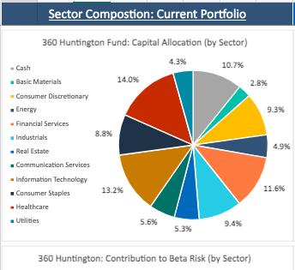
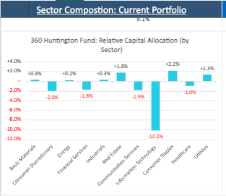
Portfolio Analysis

Slide 13
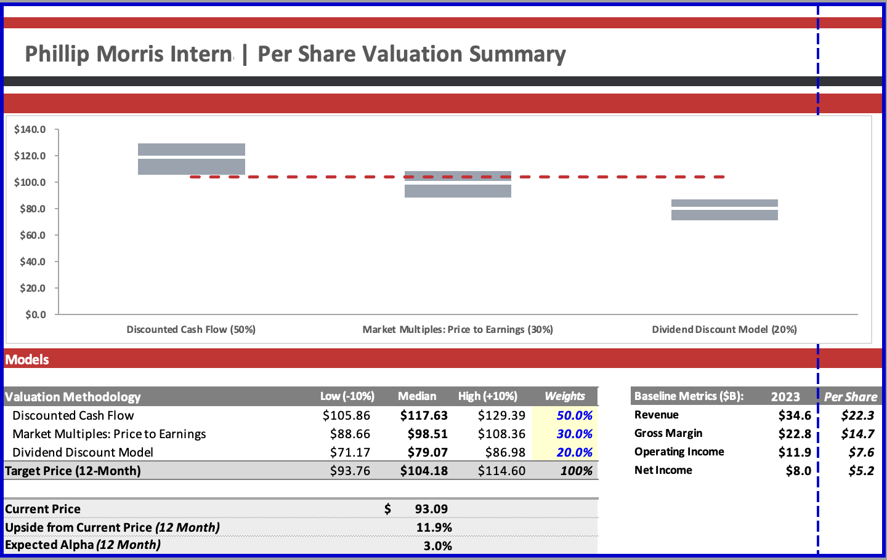
Valuation model

Slide 14
Thank you
Q&A

Slide 15
Net Revenues by Product Category

